Slide 1
计算物理展示
1.Phase transitions of Ising model and XY model
2.Interference of two condensates
徐熠 3160103037 求物1601
课程指导老师：武慧春

Slide 2
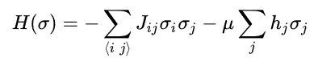
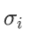
Ising Model and XY Model
Two simple mathematical model used to describe the ferromagnetism.
Ising Model can be represented as
(1)
Here is either 1 or -1. If without external fields, the second term can be dropped.
Similarly, XY Model just take all directions in the plane into consideration.
(2)
They are actually both special cases of n-vector model.

Slide 3
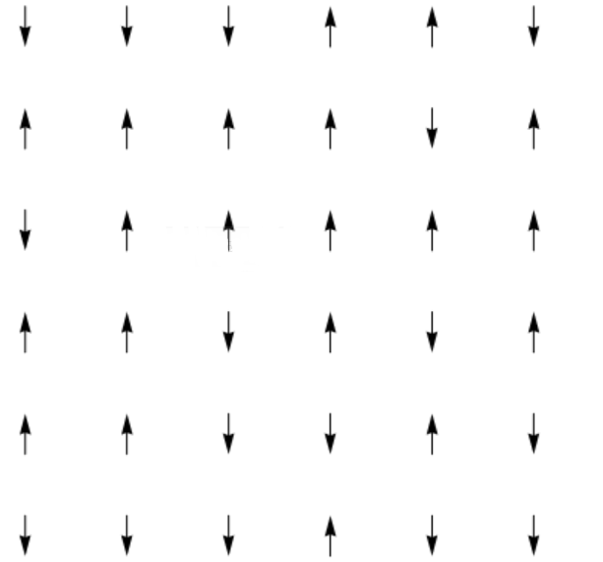
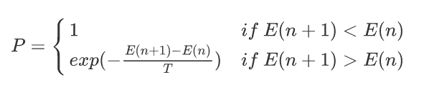
Metropolis Hastings Algorithm
Take Ising Model as an example.
1. Choose a lattice randomly
2. Recalculate the total energy of the system and get E(n+1).
3. Flip the lattice by the probability P defined as following
4. Repeat 1~3 for a number of times.

Slide 4
Metropolis Hastings Algorithm
Avoid being trapped in local minimum
local minimum
global minimum

Slide 5
Simulation - Ising Model
Parameter Setting:
N*N lattices ( N = 40 )
100 iterations, for one iteration, do N*N times Monte Carlo Sampling
J = 1

Slide 6
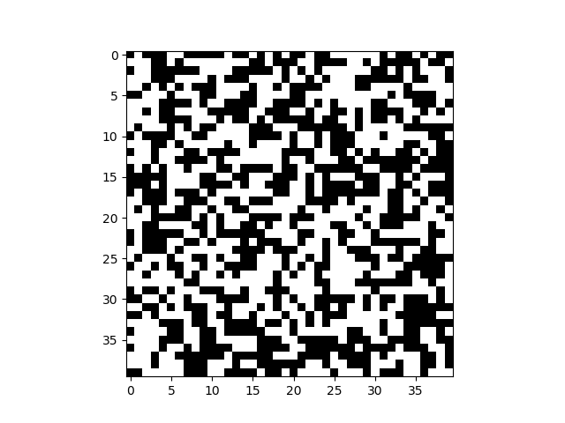
Results - Ising Model
T = 5

Slide 7
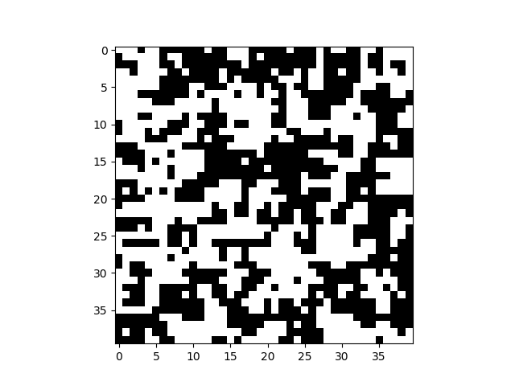
Results - Ising Model
T = 0.5

Slide 8
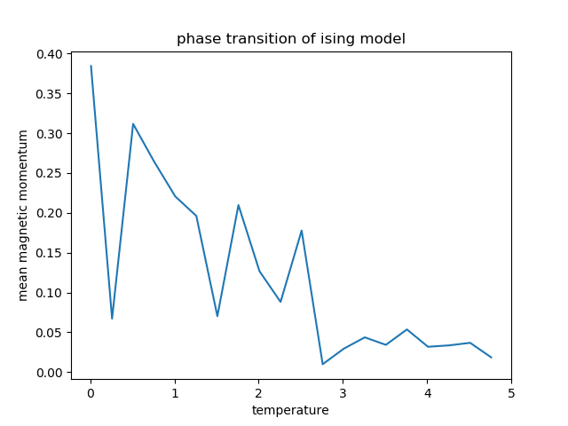
Results - Ising Model
Phase Transition
Critical temperature Tc_ising = 2.7

Slide 9
Simulation - XY Model
Parameter Setting:
N*N lattices ( N = 40 )
100 iterations, for one iteration, do N*N times Monte Carlo Sampling
J = 1

Slide 10
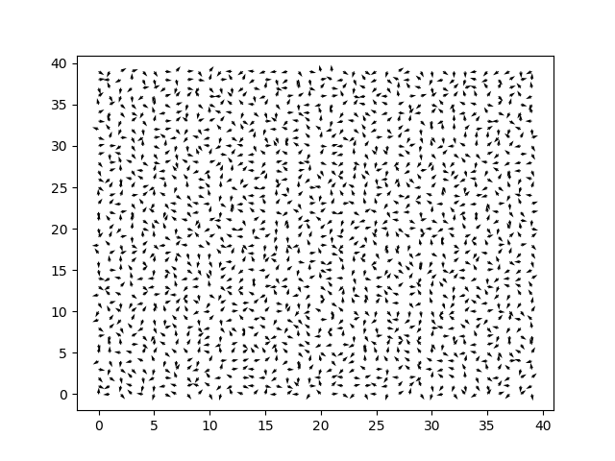
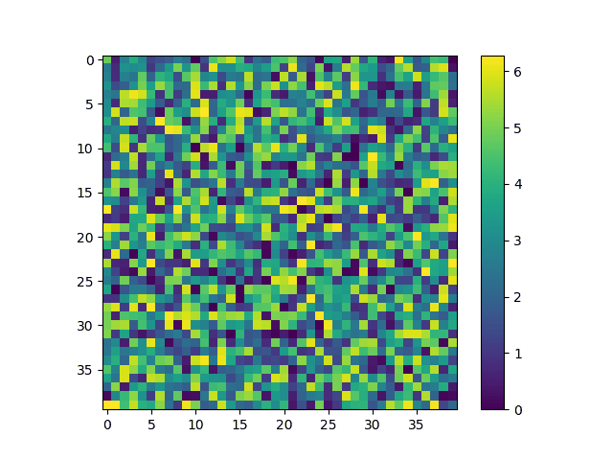
Results - XY Model
T = 5
Simulated Equilibrium State
Simulated Process

Slide 11
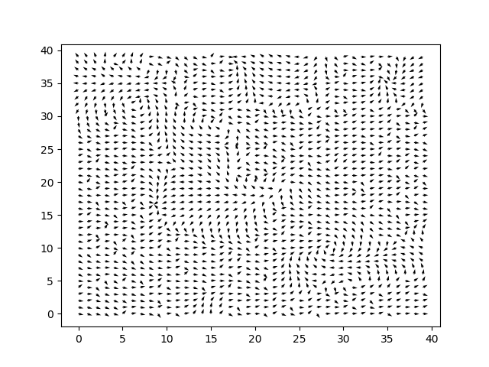
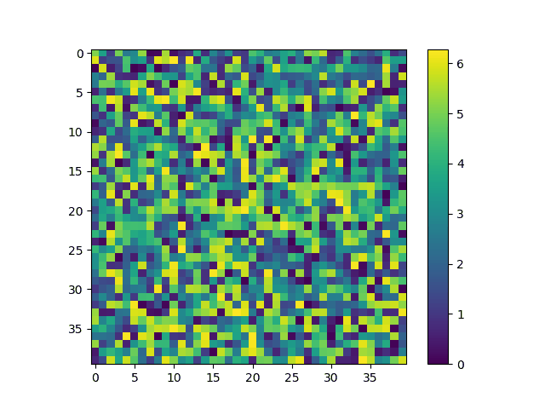
Results - XY Model
T = 0.5
Simulated Equilibrium State
Simulated Process

Slide 12
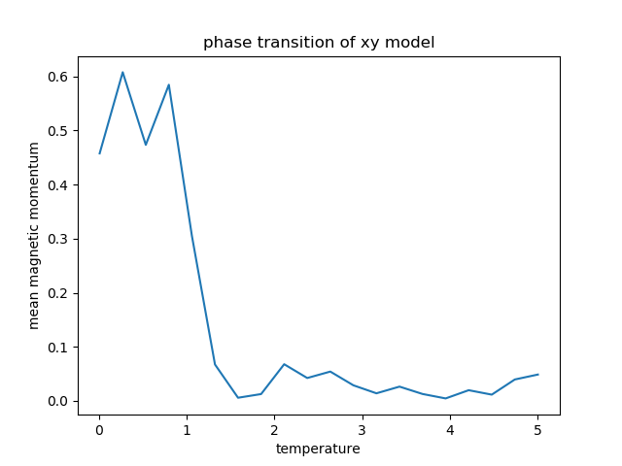
Results - XY Model
Phase Transition
Critical temperature Tc_xy = 1.3

Slide 13
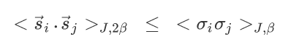
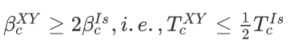
Analysis
Both Ising Model and XY Model can explain a phase transition phenomenon in ferromagnetism.
In theory, we can deduce the inequation between the critical temperatures between the two models throuth Griffiths inequality.
Hence,
This satisfies the results of the simulation.

Slide 14
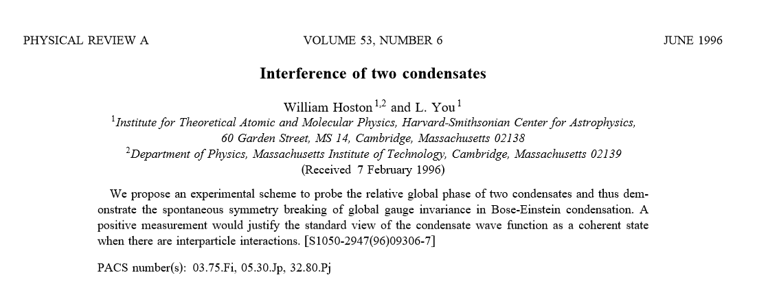
Interference of Two Condensates
Simulation based on the

Slide 15
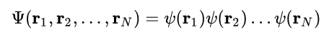
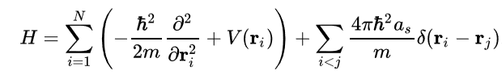
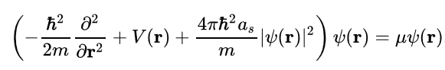
Interference of Two Condensates
Total wave function
The pseudopotential model Hamiltonian of the system is given as
Using Hartree-Fock approximation, we can get the single-particle wave function(GP equation)

Slide 16
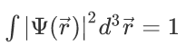
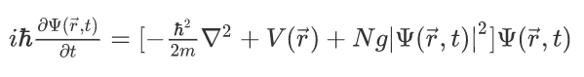
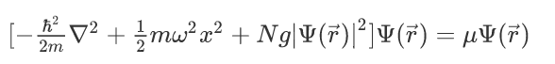
Interference of Two Condensates
Time-dependent Gross-Pitaevskii Equation
Initial condition determined by (ground state)
μ is chemical potential.

Slide 17
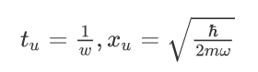
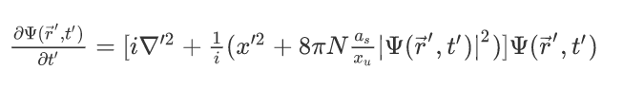
Nondimensionalization
Using Crank-Nicolson method to solve this equation.

Slide 18
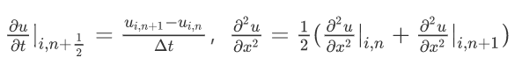
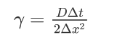
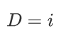
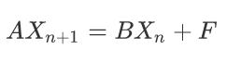
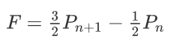
CN Method
Matrix form

Slide 19
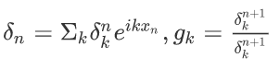
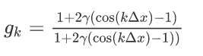
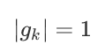
Stability Analysis
For the nonlinear term, as << xu. And here only analyze the stability of linear terms using CN Method.
Series of noises

Slide 20
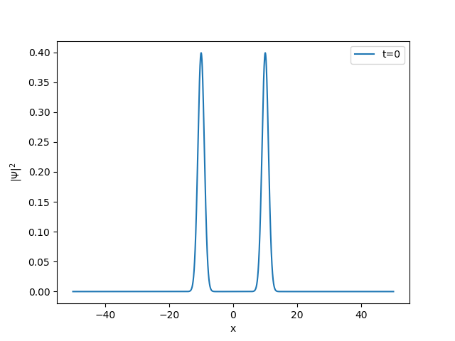
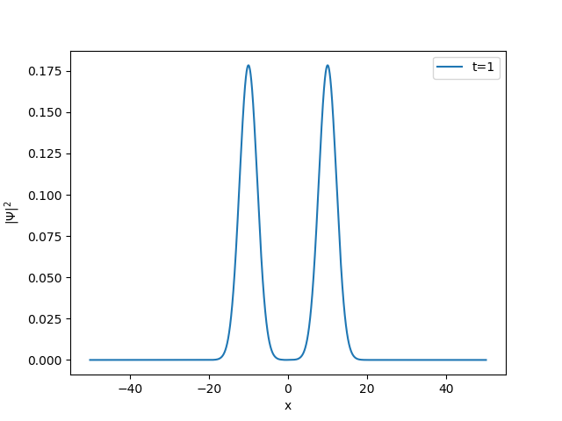
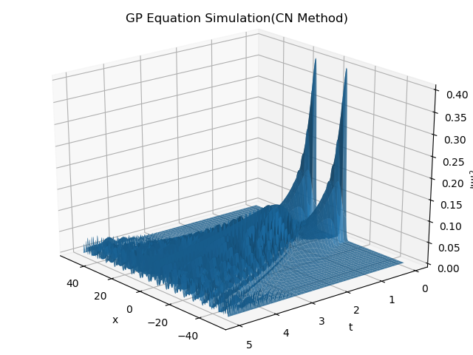
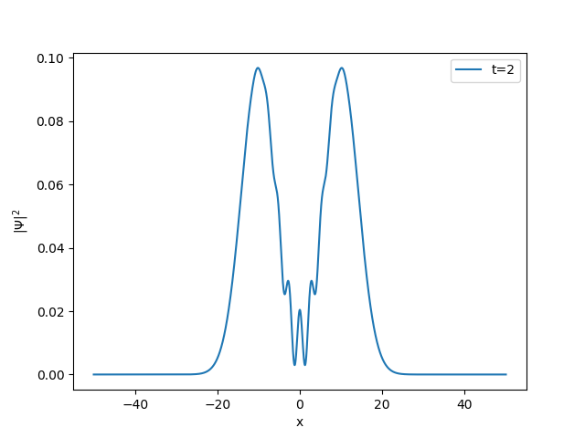
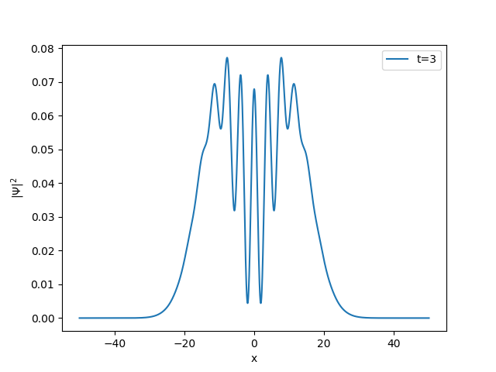
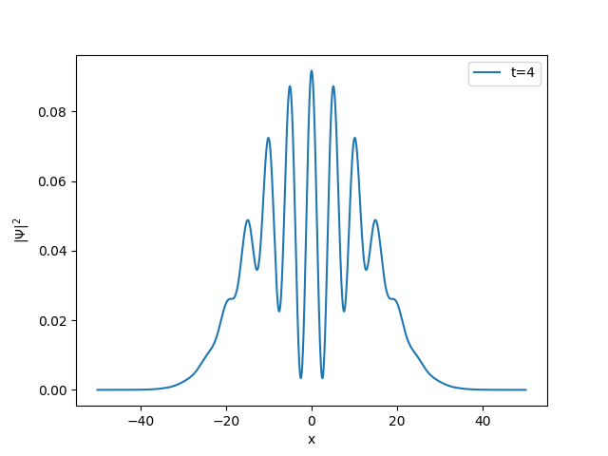
Results (without nonlinear term)
Cross section

Slide 21
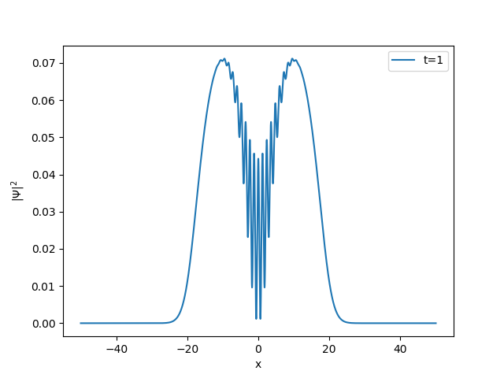
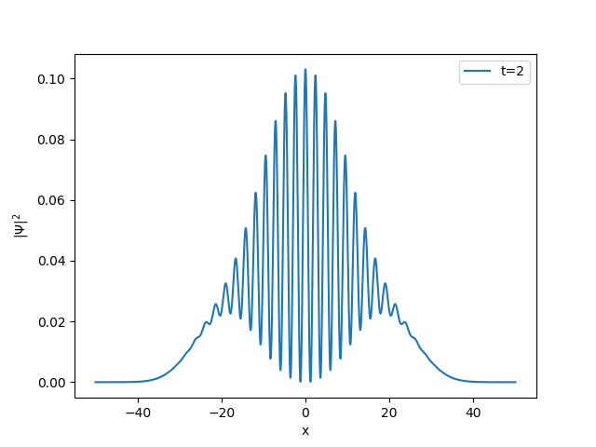
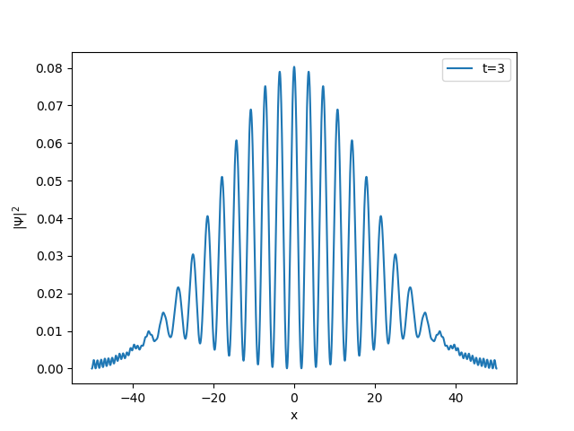
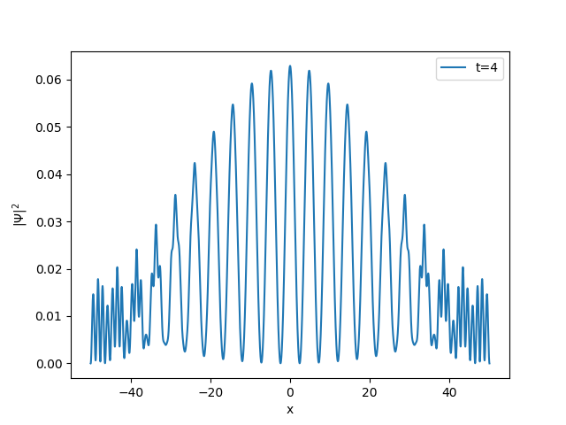
Results (with nonlinear term)
Cross section

Slide 22
References
[1] W. Hoston and L. You, Phys. Rev. A 53, 4254(1996)
[2] Kerson Huang. Statistical Mechanics. [M] New York: John Wiley and Sons, 1987.
[3] Aizenman, M.; Simon, B. (1980). "A comparison of plane rotor and Ising models". Phys. Lett. A. 76.

Slide 23
Thank You For Listening !

